Slide 1






Artificial Intelligence Concepts and Machine Learning Techniques
(AI – 103)
Walaa H. Elashmawi
Professor of AI
📧 walaa.hassan@miuegypt.edu.eg
Academic Profiles:

Slide 2
Numerical Questions

Slide 3
Topics Covered
Linear and logistic regression
Confusion matrix and performance metrics
Association rule metrics (e.g., support, confidence, …)
ANN computation using perception learning or error correction
Epoch, batch and iterations

Slide 4
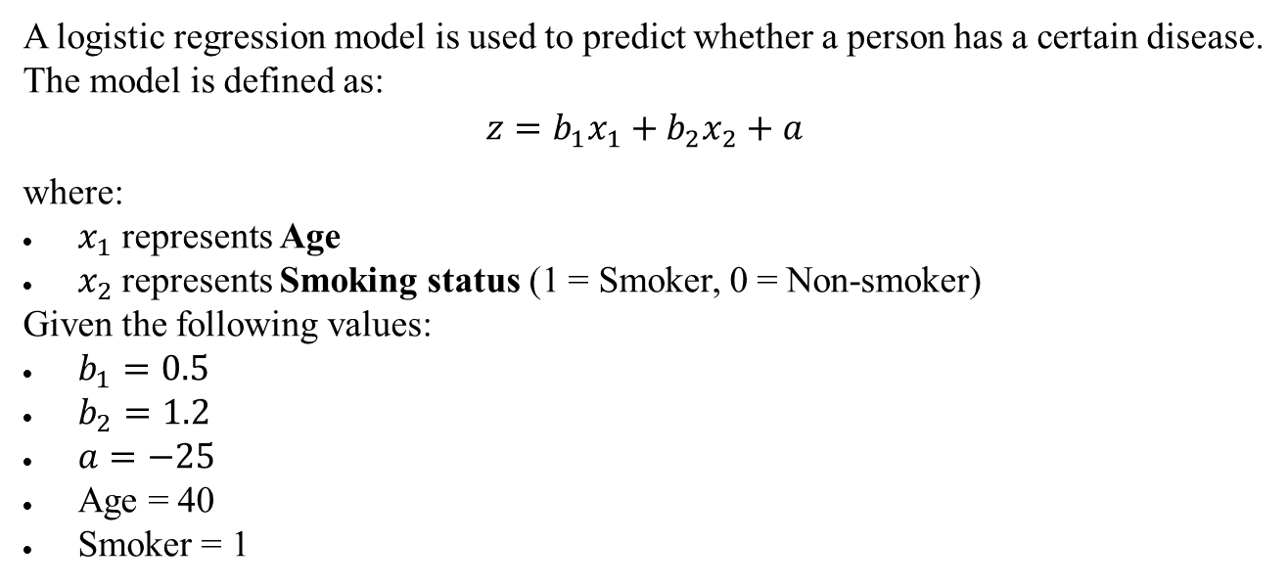
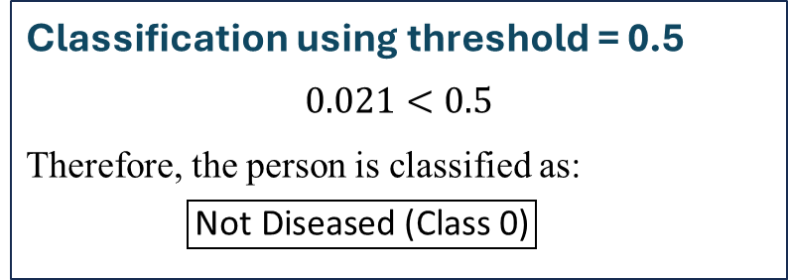
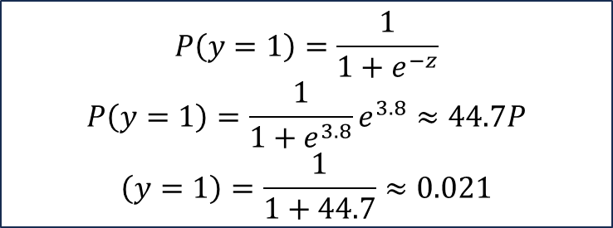
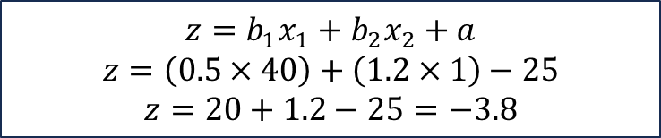
Logistic Regression
A logistic regression model is used to predict whether a person has a certain disease.
The model is defined as:
$$z=b_{1}x_{1}+b_{2}x_{2}+a$$
where:
$x_{1}$represents Age
$x_{2}$represents Smoking status (1 = Smoker, 0 = Non-smoker)
Given the following values:
$b_{1}=0.5$
$b_{2}=1.2$
$a=−25$
Age = 40
Smoker = 1
Using a threshold of 0.5, determine whether the person is classified as diseased or not diseased.
$$z=b_{1}x_{1}+b_{2}x_{2}+a$$
$$z=\left(0.5×40\right)+\left(1.2×1\right)−25$$
$$z=20+1.2−25=−3.8$$
Classification using threshold = 0.5
$$0.021<0.5$$
Therefore, the person is classified as:
$$\boxed{\text{Not} \text{Diseased}\text{ (}\text{Class} \text{0}\text{)}}$$
$$P\left(y=1\right)=\frac{1}{1+e^{−z}}$$
$$P\left(y=1\right)=\frac{1}{1+e^{3.8}}e^{3.8}≈44.7P$$
$$\left(y=1\right)=\frac{1}{1+44.7}≈0.021$$

Slide 5
Let us assume that “Cat” is the positive class and “Dog” is the negative class. So:
True positive, TP = is cat and is classified as cat = 48.
True negative, TN = is not cat and is not classified as cat = is dog and is classified as dog = 30.
False positive, FP = is not cat but is classified as cat = 50 − 30 = 20.
False negative, FN = is cat but is classified as dog = 2.
Example:
Evaluation Metrics
Accuracy = (48 + 30) / (48 + 30 + 20 + 2) = 78 / 100 = 0.78 ≈ 78%
Precision = 48 / (48 + 20) = 48 / 68 = 0.706 ≈ 70.6%
Recall = 48 / (48 + 2) = 48 / 50 = 0.96 = 96%
F1 = 2 × (0.706 × 0.96) / (0.706 + 0.96) = 0.814
78% of predictions were correct
Model detected 96% of actual positives
Balanced metric between precision & recall
70.6% of positive predictions were correct
The model seems to perform better for cat images than dog images. For this reason, the precision score of this model is somewhat lower, even though it has a higher recall score.

Slide 6
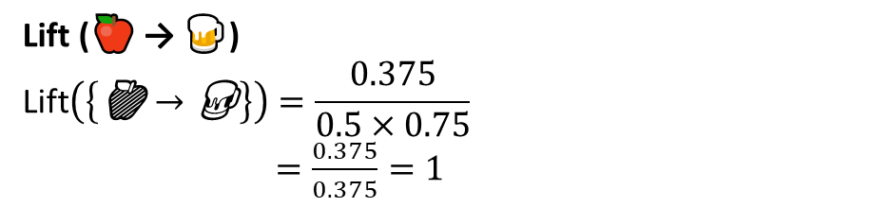
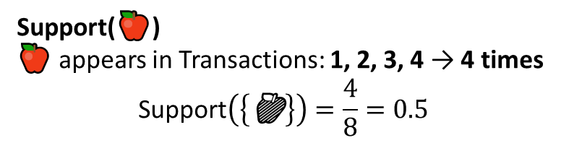
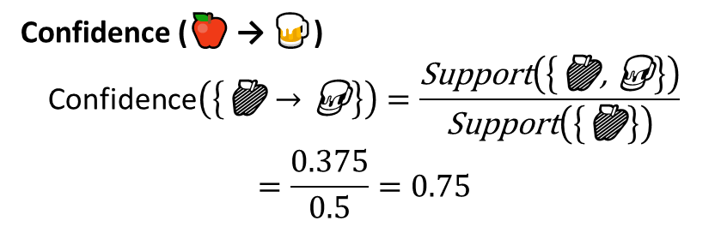
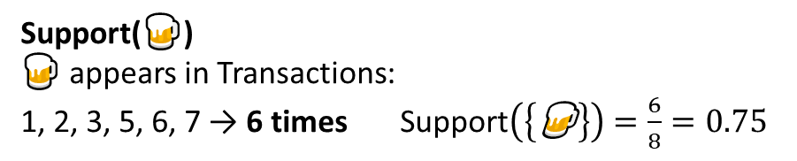
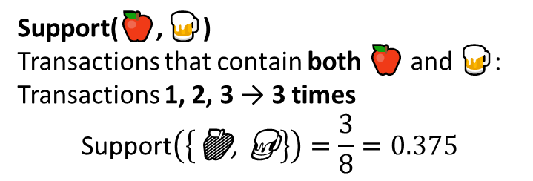
Association rule metrics
Transaction | Items
1 | 🍎 🍺 ⚪ 🍗
2 | 🍎 🍺 ⚪
3 | 🍎 🍺
4 | 🍎 🍐
5 | 🍼 🍺 ⚪ 🍗
6 | 🍼 🍺 ⚪
7 | 🍼 🍺
8 | 🍼 🍐
Support Calculation
Support(🍎)
🍎 appears in Transactions: 1, 2, 3, 4 → 4 times
$$\text{Support}\left(\left\{\text{🍎}\right\}\right)=\frac{4}{8}=0.5$$
Support(🍎, 🍺)
Transactions that contain both 🍎 and 🍺:
Transactions 1, 2, 3 → 3 times
$$\text{Support}\left(\left\{\text{🍎}\text{, }\text{🍺}\right\}\right)=\frac{3}{8}=0.375$$
Support(🍺)
🍺 appears in Transactions:
1, 2, 3, 5, 6, 7 → 6 times $\text{Support}\left(\left\{\text{🍺}\right\}\right)=\frac{6}{8}=0.75$
Confidence Calculation
Lift Calculation
Confidence (🍎 → 🍺)
$$\text{Confidence}\left(\left\{\text{🍎}→\text{🍺}\right\}\right)=\frac{\text{Support}\left(\left\{\text{🍎}\text{, }\text{🍺}\right\}\right)}{\text{Support}\left(\left\{\text{🍎}\right\}\right)}$$
$$=\frac{0.375}{0.5}=0.75$$
Lift (🍎 → 🍺)
$$\text{Lift}\left(\left\{\text{🍎}→\text{🍺}\right\}\right)=\frac{0.375}{0.5×0.75}$$
$=\frac{0.375}{0.375}=1$
When customers buy 🍎, 75% of the time they also buy 🍺.
🍎 and 🍺 occur together exactly as expected by chance.
There is no strong association (Lift = 1).

Slide 7
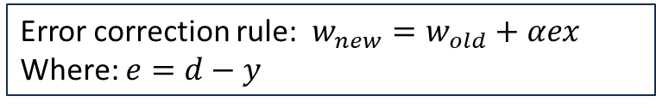
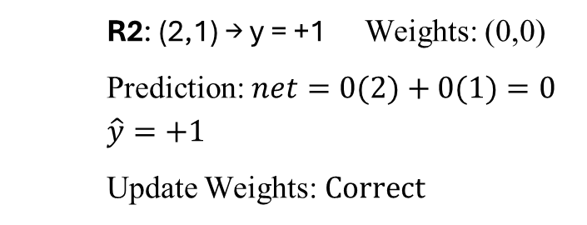
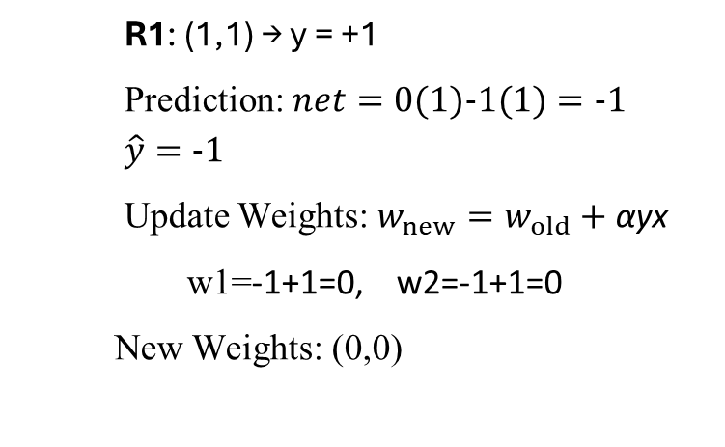
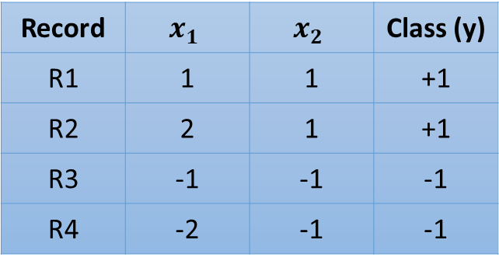
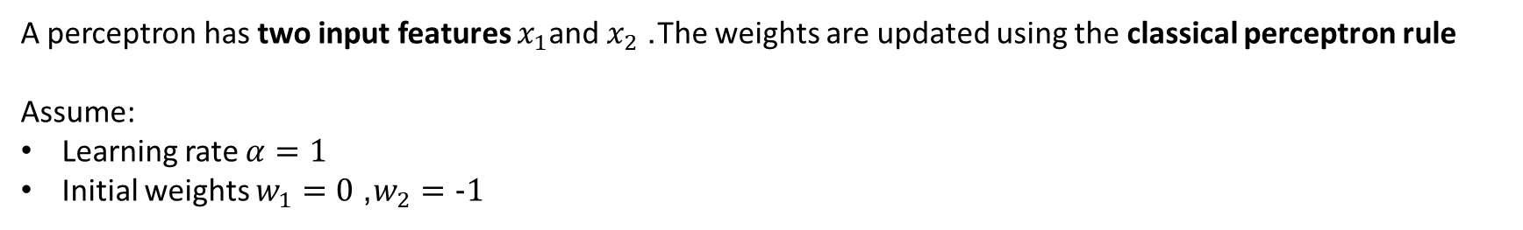
ANN model (Perceptron)
A perceptron has two input features $x_{1}$and $x_{2}$. The weights are updated using the classical perceptron rule
Assume:
Learning rate $α=1$
Initial weights $w_{1}=0$, $w_{2}=-1$
Update the weights sequentially for the four training records and determine the final weight vector after one epoch.
R1: (1,1) → y = +1
Prediction: $net=0(1)-1(1)=-1$
$\hat{y}=-1$
Update Weights: $w_{new}=w_{old}+\text{α}\text{yx}$
w1=-1+1=0, w2=-1+1=0
New Weights: (0,0)
R2: (2,1) → y = +1 Weights: (0,0)
Prediction: $net=0(2)+0(1)=0$
$\hat{y}=+1$
Update Weights: $Correct$
Record | $$x_{1}$$ | $$x_{2}$$ | Class (y)
R1 | 1 | 1 | +1
R2 | 2 | 1 | +1
R3 | -1 | -1 | -1
R4 | -2 | -1 | -1
Note
Error correction rule: $w_{new}=w_{old}+αex$
Where: $e=d−y$
Final weights after training all examples

Slide 8
Epoch, batch and iterations
Dataset Size: 10,000 samples
Batch Size: 1,000 samples
Epochs: 10
Number of Batches per Epoch:
Batches Per Epoch=Dataset Size / Batch Size =10,000 / 1,000=10
Total Training Batches for 10 Epochs:
Total Batches=Number of Epochs × Batches Per Epoch=10×10=100
Number of iterations = number of passes
one pass = one forward pass + one backward pass
Ex: 1000 training examples, batch size is 500, then it will take 2 iterations to complete 1 epoch.

Slide 9


